Slide 1

Data 205 Final Project
David Williams

Slide 2
Contents
Montgomery College Enrollment
Tuition Assistant
College Level Characteristics from the IPEDS Database and the College Scorecard

Slide 3

Montgomery College Enrollment

Slide 4
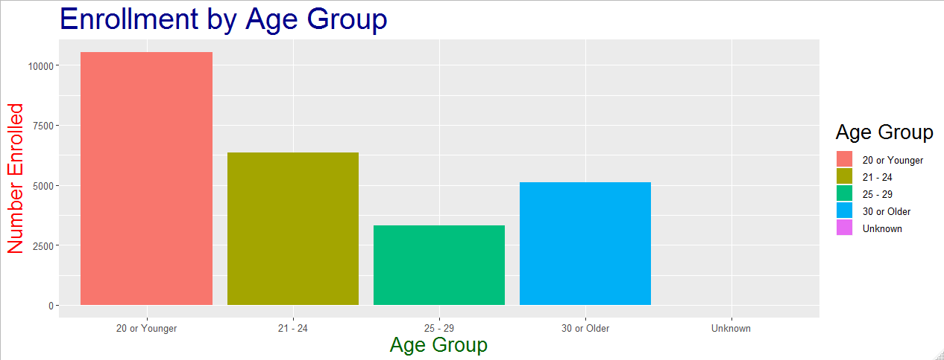

Slide 5
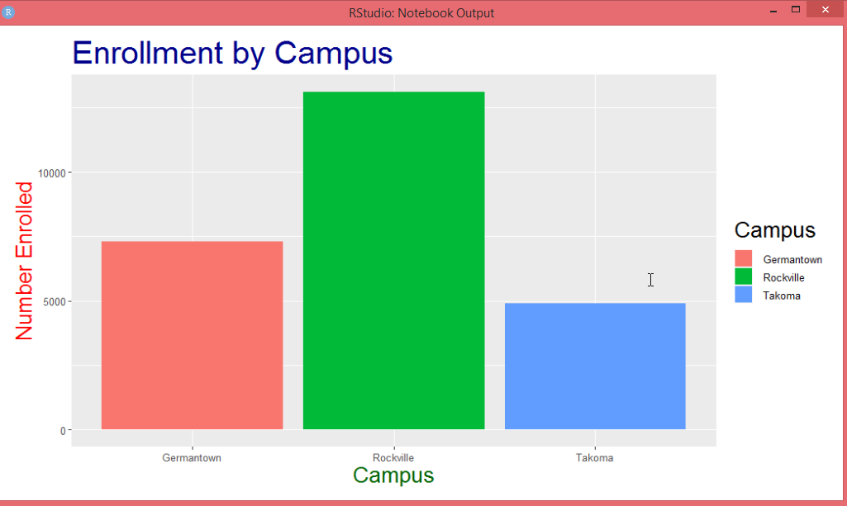

Slide 6
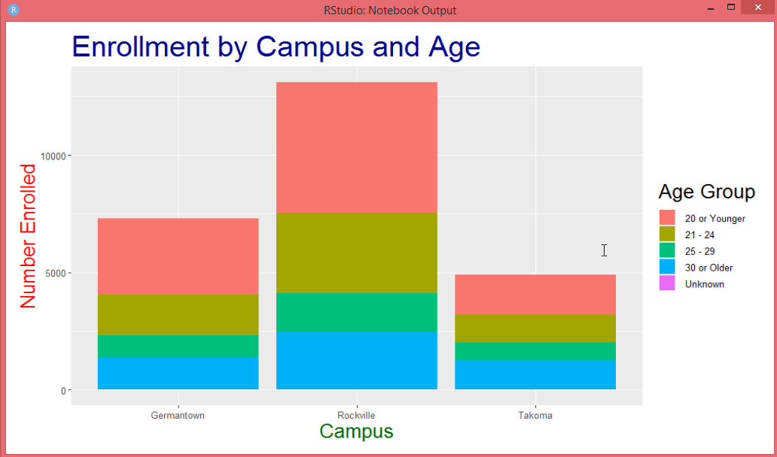

Slide 7
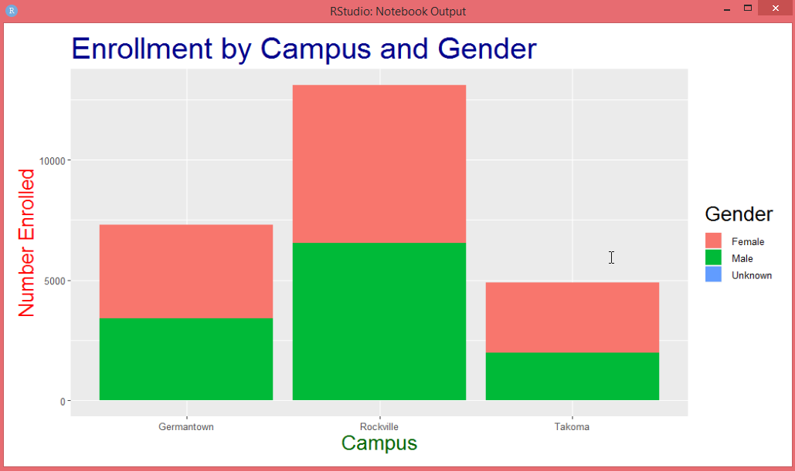

Slide 9
Tuition Assistant
https://public.tableau.com/profile/david.williams8099#!/vizhome/TuitionAssistant/CountofDegreesbyDepartment?publish=yes
https://public.tableau.com/profile/david.williams8099#!/vizhome/TuitionAssistant/CountofMajorperDegree?publish=yes
https://public.tableau.com/profile/david.williams8099#!/vizhome/TuitionAssistant/AvgCostperDepartment?publish=yes

Slide 10
College Level Characteristics from the IPEDS Database and the College Scorecard

Slide 11
Tableau
https://public.tableau.com/profile/david.williams8099#!/vizhome/montgomerycountycolleges/MontgomeryCollegeDashboard?publish=yes
https://public.tableau.com/profile/david.williams8099#!/vizhome/averageearningbyschool/Sheet1?publish=yes
https://public.tableau.com/profile/david.williams8099#!/vizhome/averageearningbyschool/Sheet2?publish=yes

Slide 12

References
Montgomery College Enrollment
https://data.montgomerycountymd.gov/Education/Montgomery-College- Enrollment-Data/wmr2-6hn6
Tuition Assistant
https://data.montgomerycountymd.gov/resource/p7z5-tjrz.csv
College Level Characteristics from the IPEDS Database and the College Scorecard
https://opportunityinsights.org/data/

